Slide 1

MIS 5613 FALL 2024 – GROUP 5 DATA MINING & TEXT ANALYTICS IN BUSINESS REAL OR FAKE JOB POSTING PREDICTION -"Leveraging Data to Protect Job Seekers and Ensure Trust"

Slide 2
Agenda
Introduction
Dataset Summary
Preprocessing Steps
Model Selection
Evaluation & Results
Insights & Recommendations
Conclusion & Future Work

Slide 3
Introduction
Fake job postings harm job seekers and erode trust.
Goal: Develop a machine learning model to identify fraud.

Slide 4
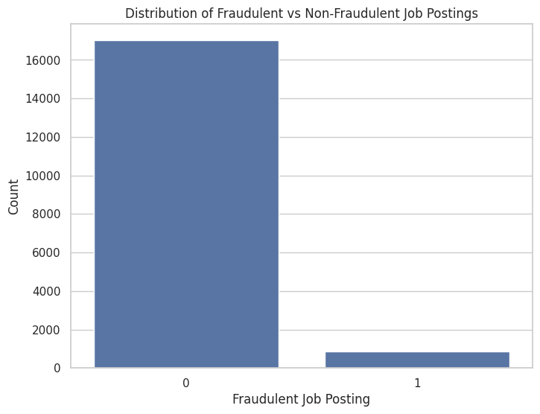
Dataset Overview
Source: Kaggle
Records: 17,880
Attributes: 18 (e.g., title, location, salary)
Graph showing Distribution of Fraudulent Job Posting vs Non-Fraudulent Job Postings

Slide 5
Preprocessing Steps
Raw Data
Handling Missing Values
Text Normalization
Tokenization & Stopword Removal
Cleaned Data
"Looking for a highly motivated individual to JOIN our team ASAP!! Email resume to jobs@example.com!"
"looking highly motivated individual join team email resume jobs"
Steps Applied:
Converted to lowercase
Removed punctuation and special characters
Removed stopwords

Slide 6
Model Selection & Performance
Comparison Table
Metric | Decision Tree (Initial) | Decision Tree (Tuned)
Precision | High for Legitimate | Improved for Fraudulent
Recall | Moderate for Fraudulent | Slightly Lower for Fraudulent
F1-Score | Balanced | Higher for Legitimate
Accuracy | 85% | 89%
ROC Curve and Confusion Matrix
ROC Curve:
Plot True Positive Rate vs. False Positive Rate.
Show AUC improvement after tuning.
Confusion Matrix:
Legitimate: High True Positives
Fraudulent: Reduced False Positives after tuning

Slide 7

Model Selection: Classification
We chose classification as our modeling approach due to its effectiveness in categorizing data into predefined groups.
Supervised learning with labeled data enables us to train models to make predictions based on past examples.

Slide 8
Actionable Insights
Logos Indicate Credibility: 79.5% of legitimate postings have logos.
Part-Time Roles Prone to Fraud: 11.8% of fraudulent postings are part-time vs. 5.2% legitimate.

Slide 9
Future Directions
Visual Split for Suggestions
Advanced ML Techniques:
Deep Learning (e.g., LSTM, Transformers) for better fraud detection.
Ensemble Methods to combine Decision Trees with boosting or bagging.
Collaboration with Job Platforms:
Work with industry leaders to refine detection.
Implement real-time fraud alerts.
Continuous Updates for Fraud Tactics:
Regular dataset updates.
Monitor evolving patterns in fraudulent postings.

Slide 10

References
Kaggle Dataset: Real or Fake Job Posting Prediction
Natural Language Toolkit (NLTK) documentation
Scikit-learn documentation for Decision Tree Classifier and model evaluation metrics

Slide 11
THANK YOU!
Presented by,
Bhargav Manishankar Pothuraju
Naveen Kumar Vankudoth
Sai Jaganadh Kovuri
Sharvani Guduru

